Slide 1
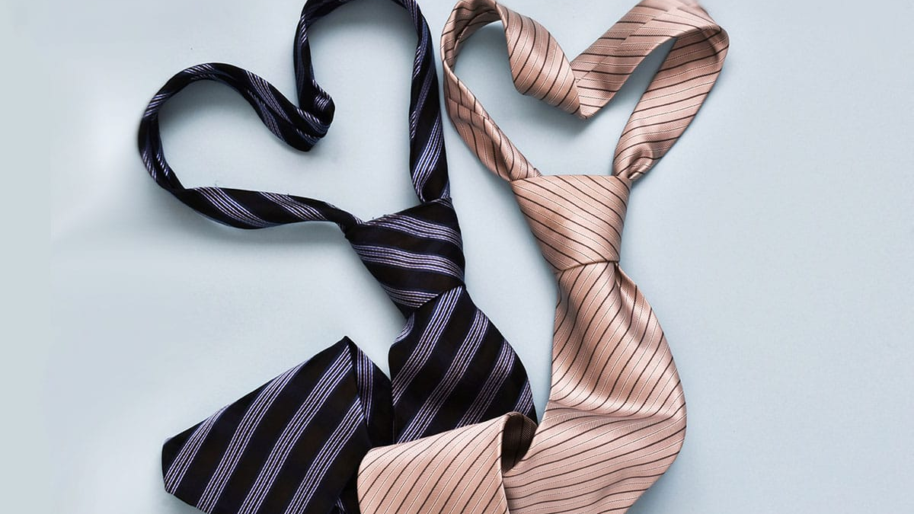
World tie day

Slide 2
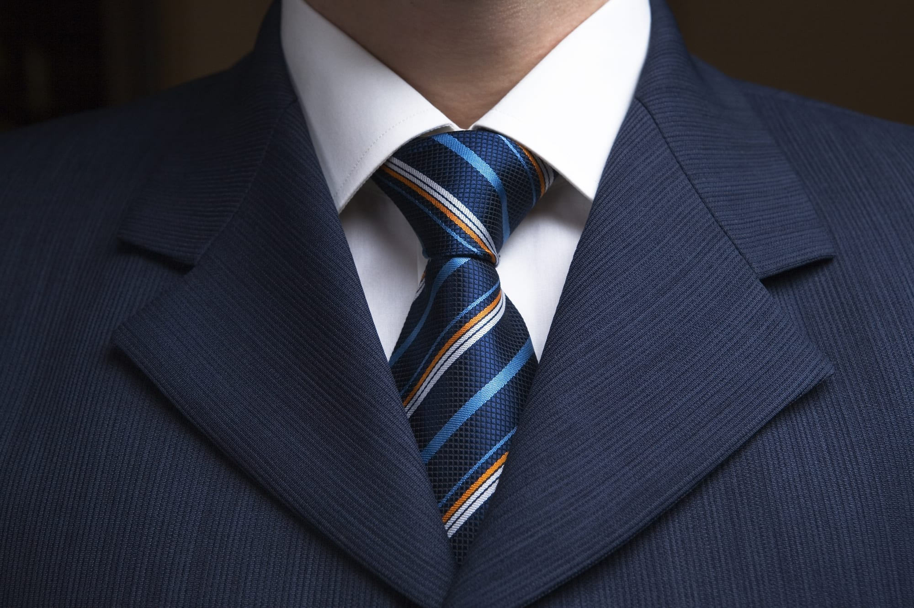
RULES
Basic rules about matching a tie and a shirt: solid-colored ties can be worn with "playful" shirts or shirts with patterns.
On the other hand, if the tie is patterned, it goes well with a plain shirt. Just remember, never match patterns with patterns.

Slide 3
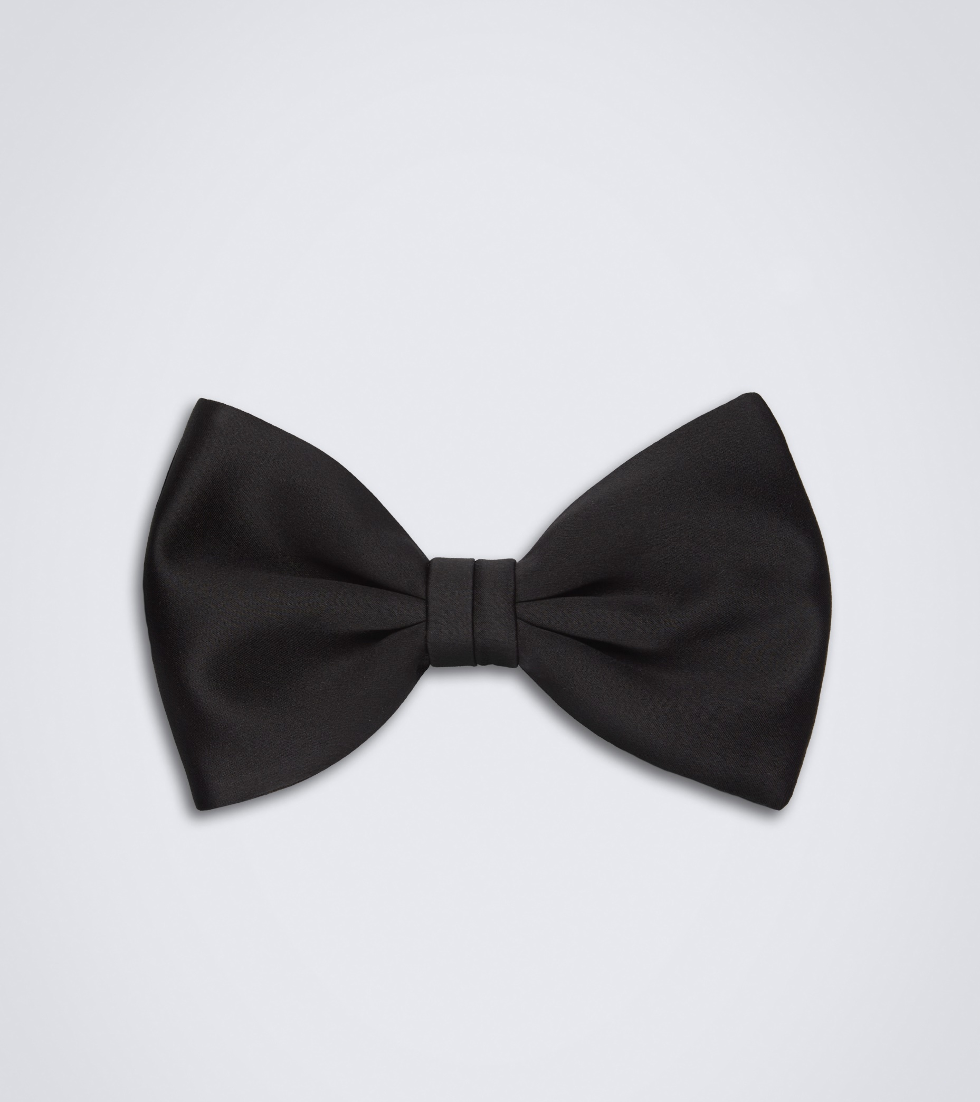
The wider end should be lower, i.e. longer than the thinner part, covering it at the same time.
You also don't want your tie to hang too low. The rule is that the lowest part of your tie touches the belt buckle, or the top part of your pants if you are not wearing a belt.
Use a mirror to help you tie your tie. You also need a mirror to measure the right length of the tie and that it fits your shirt properly.

Slide 4
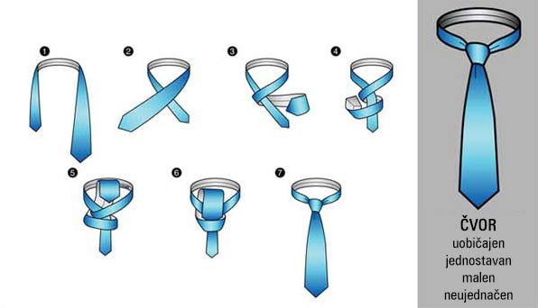
WAYS OF TYING TIES
a simple knot

Slide 6
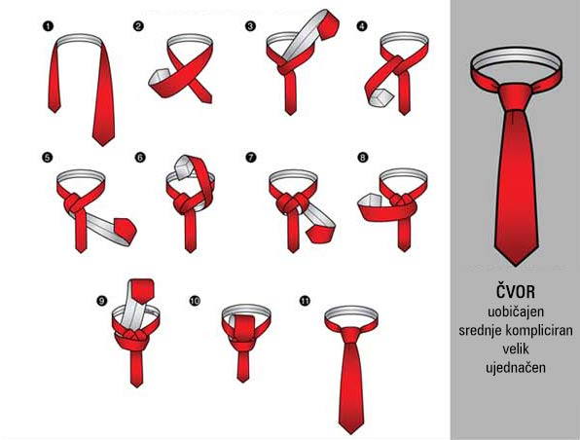
Windsor knot

Slide 9
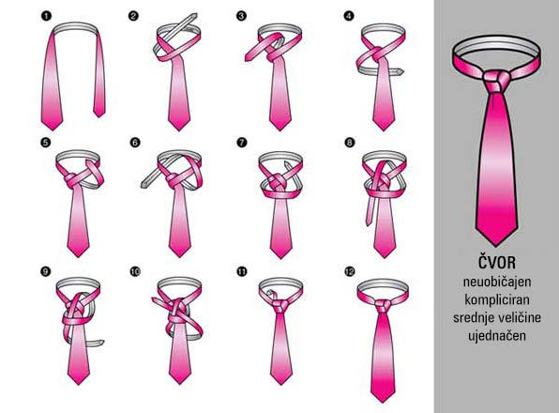
Trinity knot

Slide 14
this is a video on how to put on a tie

Slide 15
The history of the tie dates back to the 17th century
At that time, fashionable accessories such as scarves and handkerchiefs were very popular in Europe
In France, men wore long, narrow strips of fabric around their necks, which were called cravats
These cravats were worn by nobles and wealthy citizens as a fashion statement

Slide 16
It’s so easy and quick to tie a time
There od do much ways
Once you learn it
You can’t forget it

Slide 17
During the 18th century, cravats became increasingly elaborate, adorned with lace, embroidery, and other decorations
They also became wider and came in various colors and patterns
In the early 19th century, the modern necktie finally emerged, which was narrower and simpler in design than the ornate cravats of the 18th century

Slide 18
The end

