Slide 1
World Tie Day
Mateo Dogan, Josip Šučurović, Luka Trehub, Mihael Matanović

Slide 2
Historical Roots
The history of the necktie can be traced back to the 17th century during the Croatian War of the Thirty Years.
We will unravel the story of how the Croatian "Cravat" became the modern necktie.

Slide 3
Birth of the Modern Tie
Learn about the role of French visitors who were enamored by Croatian soldiers' neckwear, which eventually evolved into the modern necktie.
The journey of the necktie from its historical roots to the international fashion scene.

Slide 5
Professional Symbolism
Ties convey authority and seriousness in professional settings.
They are often a requirement for dress codes, reflecting respect for tradition.

Slide 6
Evolution of Style
Ties have evolved over time in terms of design, size, and materials.
From extravagant and colorful ties to sleek, minimalist ones, they reflect changing fashion trends.

Slide 7
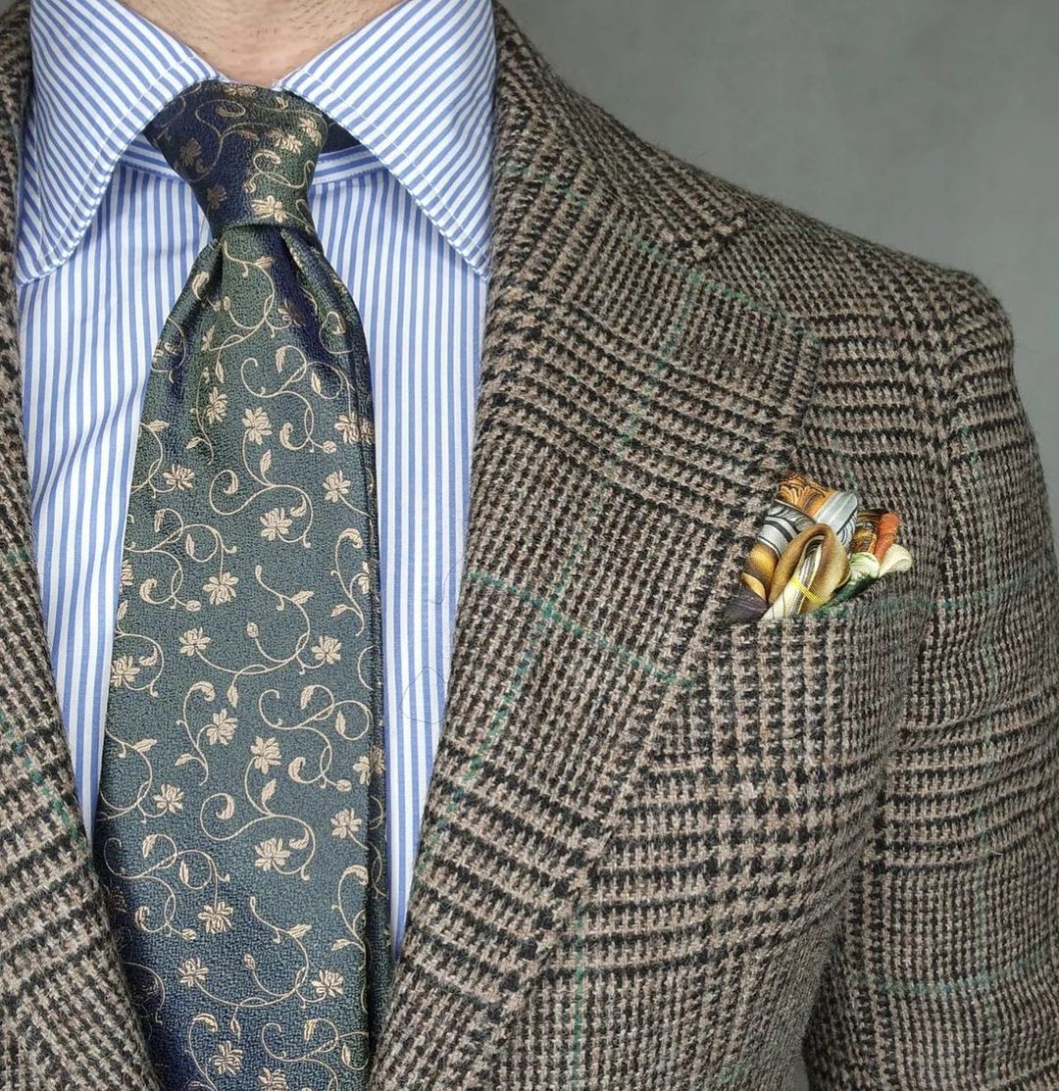

Slide 8
Cultural Significance
The tie holds cultural significance in many parts of the world.
It's a symbol of formality, professionalism, and personal style.

Slide 9
World Tie Day Celebration
This day is celebrated on October 18. to honor the tie's historical and cultural significance.
It's a global celebration that recognizes the tie's impact on fashion and culture.

Slide 10
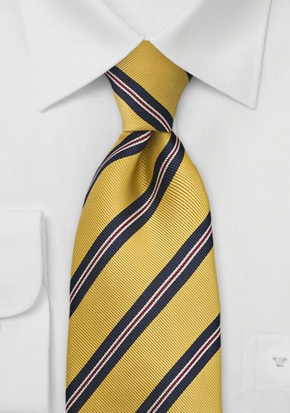

Slide 11
Embracing Elegance
Ties are associated with elegance, class, and sophistication.
They continue to be a symbol of timeless fashion.

Slide 12
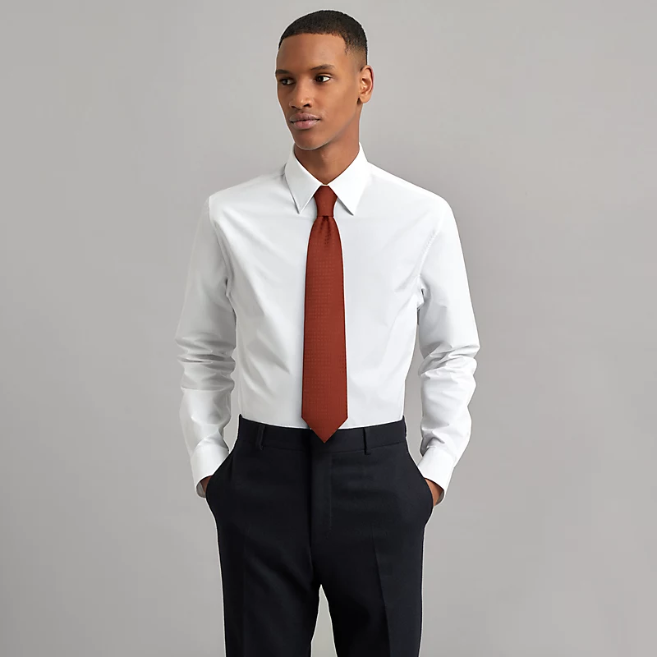

Slide 13
Collecting Ties
Tie collecting has become a hobby for many enthusiasts.
Some collect ties for their historical value or unique designs.

Slide 14
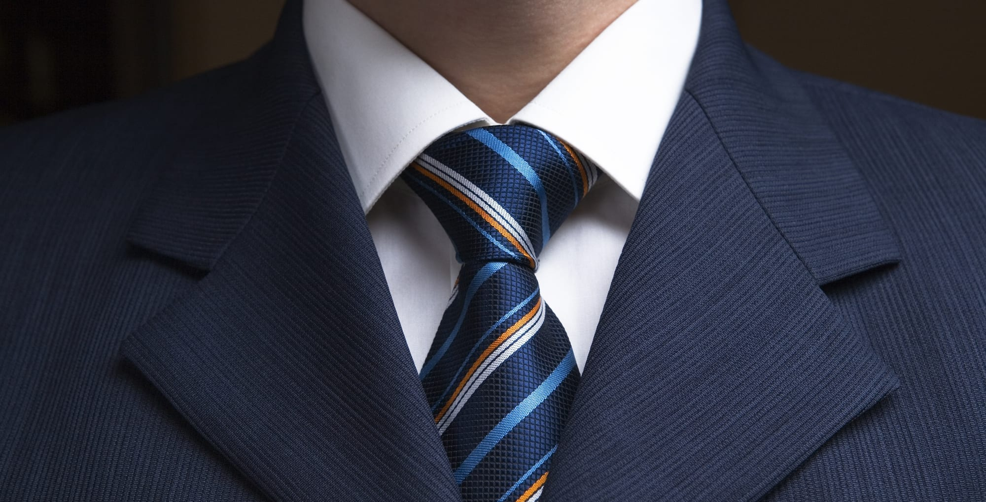

Slide 15
Tie-Related Charities
Some organizations use Tie Day to raise awareness and funds for charitable causes.
They leverage the tie's symbolism to support various charitable efforts.

Slide 16
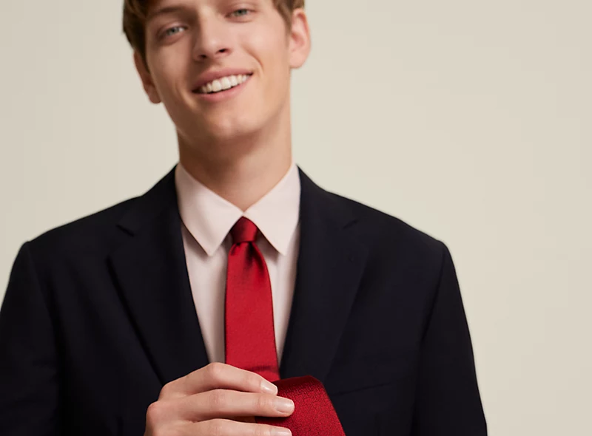

Slide 17
Conclusion
In conclusion, Tie Day celebrates a timeless fashion accessory with historical, cultural, and personal significance.
It's a day to appreciate the tie's enduring influence and versatility in the world of fashion.

Slide 18
THE END

