Slide 1
TIE
Mihael Karadža,Marko Zirdum,Marin Majstorović,Deni Šimić,Petar Skoćibušić 2.b

Slide 2
TIE
A tie is decorative piece of clothing ,in the form of a ribbon,worn around the neck and tucked uner the collar of a shirt,made of silk or some oder fabric

Slide 3
Tie throughout history
1635
Around 1635. some six thousand soldiers and knights arrived in the Paris to suppport the French king Louis XIII.among them was a large number of Croatian mercenaries
1650
This ''croatian elegant style'',completly unkown in Europe at the time was accepted at the French court aroun 1650. and became a fashionable clothing item among the bourgeoisie of that time as a symbol of culture and elegance

Slide 4
The tie, considered an original Croatian product,spread throught Europe in the 17th century through Croatian soldiers in the Thirty years war
The French were among the first to accept it

Slide 5
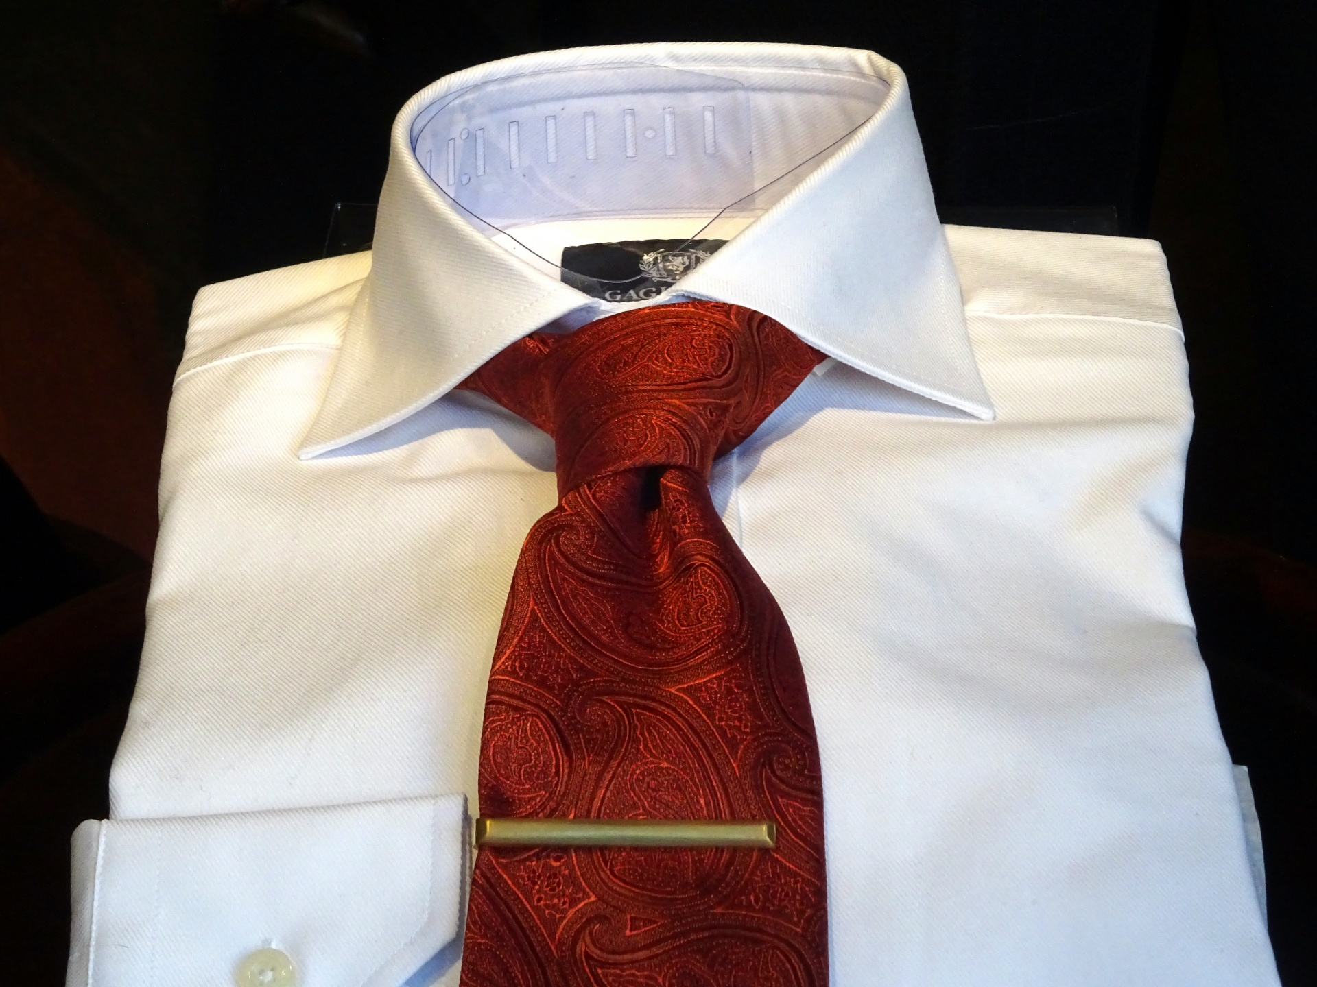
Tie day
18 Oct. 2003
Tieday has been celebrated since October 18,2003
17 Oct. 2008
On October 17,2008 Croatian parliament paid a special tribute to the tie by declaring the Day of the Tie,which is celebrated on october18.Since then Tie day has been officially cellebrated in Croatia

Slide 6
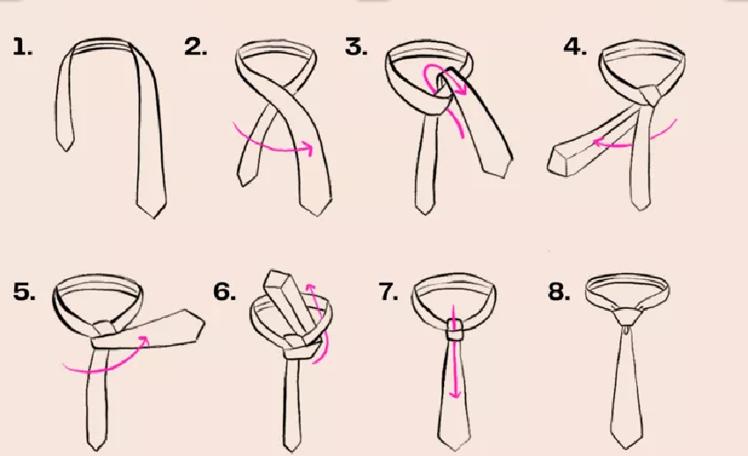
how to tie a tie
To begin tying the full Windsor knot, raise the shirt collar and drape the tie around the neck, so the wide end is on the right side and extends about 12 inches below the narrow end.

Slide 7
2. Cross the wide part of the tie over the narrow part.

Slide 8
3. Pull the wide end up through the opening at the neck, then down.

Slide 9
4. Pass the wide end underneath and to the right of the narrow part with the wrong side facing out.

Slide 10
5. Cross the wide part over and to the left of the narrow part with the correct side facing out.

Slide 11
6. Pull the wide end up through the opening at the neck.

Slide 12
7. When bringing it down, pass it through the loop at the front.

Slide 13
8. Holding the dangling parts with one hand, slide the knot carefully up toward the collar with the other hand until snug, then lower the collar.

Slide 14
THE END

Slide 15
SOURCES
Tie - Wikipedia
tie wikipedia - Google pretraživanje
how to tie a tie - Google pretraživanje
How to Tie a Tie | 7 Easy Tie Knots for Any Occasion (theknot.com)

