Slide 1
NATIONAL NECKTIE DAY
IVANO ŠUKER
STJEPAN ČEPO
IVAN LONČAR
MATKO BOŠKOVIĆ
PETAR NALBANI

Slide 3
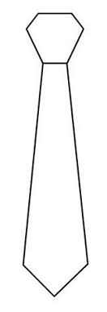
Necktie
A necktie, or simply a tie, is a piece of cloth worn for decorative purposes around the neck, resting under the shirt collar and knotted at the throat, and often draped down the chest.

Slide 5
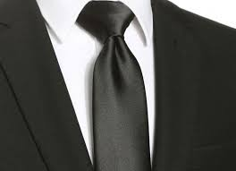
Variants include the ascot, bow, bolo, zipper tie, cravat, and knit. The modern necktie, ascot, and bow tie are descended from the cravat. Neckties are generally unsized but may be available in a longer size. In some cultures, men and boys wear neckties as part of office attire or formal wear. Women wear them less often. Neckties can also be part of a uniform. Neckties are traditionally worn with the top shirt button fastened, and the tie knot resting between the collar points.

Slide 7
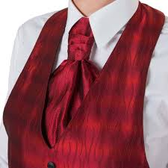
History
The necktie that spread from Europe traces back to Croatian mercenaries serving in France during the Thirty Years' War (1618–1648). These mercenaries from the Military Frontier, wearing their traditional small, knotted neckerchiefs, aroused the interest of the Parisians.[2] Because of the difference between the Croatian word for Croats, Hrvati, and the French word, Croates, the garment gained the name cravat (cravate in French).[3] Louis XIV began wearing a lace cravat around 1646 when he was seven and set the fashion for French nobility.

Slide 8
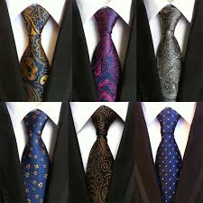
This new article of clothing started a fashion craze in Europe; both men and women wore pieces of fabric around their necks. From its introduction by the French king, men wore lace cravats, or jabots, which took a large amount of time and effort to arrange. These cravats were often tied in place by cravat strings, arranged neatly and tied in a bow. International Necktie Day is celebrated on October 18 in Croatia and in various cities around the world, including in Dublin, Tübingen, Como, Tokyo, Sydney and other towns.

Slide 10
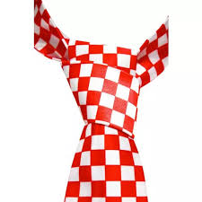
1710–1800: stocks, solitaires, neckcloths, cravats
In 1715, another kind of neckwear, called "stocks" made its appearance. The term originally referred to a leather collar, laced at the back, worn by soldiers to promote holding the head high in a military bearing. The leather stock also afforded some protection to the major blood vessels of the neck from saber or bayonet attacks. General Sherman is seen wearing a leather stock in several American Civil War-era photographs.

Slide 11
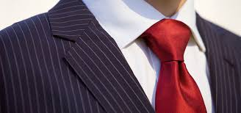
Stock ties were initially just a small piece of muslin folded into a narrow band wound a few times around the shirt collar and secured from behind with a pin. It was fashionable for men to wear their hair long, past shoulder length. The ends were tucked into a black silk bag worn at the nape of the neck. This was known as the bag-wig hairstyle, and the neckwear worn with it was the stock. The solitaire was a variation of the bag wig. This form had matching ribbons stitched around the bag. After the stock was in place, the ribbons would be brought forward and tied in a large bow in front of the wearer.

Slide 12
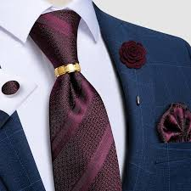
Sometime in the late 18th century, cravats began to make an appearance again.This can be attributed to a group of young men called the macaronis (as mentioned in the song "Yankee Doodle"). These were young Englishmen who returned from Europe and brought with them new ideas about fashion from Italy. The French contemporaries of the macaronis were the 'petits-maîtres' and incroyables

Slide 13
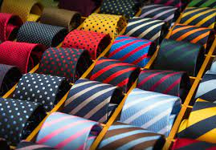
1800–1850: cravat, stocks, scarves, bandanas.
At this time, there was also much interest in the way to tie a proper cravat and this led to a series of publications. This began in 1818 with the publication of Neckclothitania, a style manual that contained illustrated instructions on how to tie 14 different cravats. Soon after, the immense skill required to tie the cravat in certain styles quickly became a mark of a man's elegance and wealth.[5] It was also the first book to use the word tie in association with neckwear.

