Slide 1
International Tie Day
WHEN TO WEAR A TIE, CELEBRITIES AND TIES

Slide 2
CELEBRATIONS
A tie is a key element in dressing for celebrations such as birthdays, weddings, baptisms or anniversaries. This element will help you emphasize your presence, the festive character of the celebration, and at the same time you will express your respect for the host of the party and the efforts they put into organizing the event.

Slide 3
LEVEL OF FORMALITY
If you want to look less formal at the wedding, then a bow tie is the right choice for you. Also, a bow tie is an ideal choice when you want to stand out and attract the attention of others. On the other hand, if you want a classic, more serious and formal wedding outfit, then ties are the perfect choice.

Slide 4
FUNERALS
Although no one wants to attend such events, the truth is that going with them is your mark on the wearer, because you show respect for the deceased person and his family. These occasions require that the tie worn must be dark, preferably black.

Slide 5
FORMAL MEETINGS AND WORK
The use of a tie is also recommended in those occasions when you meet formally with friends or acquaintances, such as in the theater or the opera. You will also be required to wear a tie in certain restaurants and entertainment venues.

Slide 6
FORMAL MEETINGS AND WORK
The use of a tie is also recommended in formal business meetings. That is, if you have to go to the bank to apply for a loan, buy a car or meet with your lawyer. A tie will give you seriousness and an image of trust.

Slide 7
PROFESSIONAL PERFORMANCES
If you are involved in art, music, theater or other professions that require stage performances, a tie can serve as part of your scenography.

Slide 8
ACCORDING TO YOUR OWN DESIRE
Of course, you can wear a tie whenever you want, regardless of the occasion. It's a matter of personal style and choice. It is important to note that the obligation to wear a tie is often related to the level of formality of the occasion and the specific requirements of the employer or event organizer, but it's also important to be comfortable and match your own style.

Slide 9
TIES ON RED CARPET
Ties often play a significant role on the red carpet at events such as movie premieres, film awards, music ceremonies and similar formal occasions. On the red carpet, public figures, actors, musicians and other celebrities often use their appearance to express their style and personality.

Slide 10
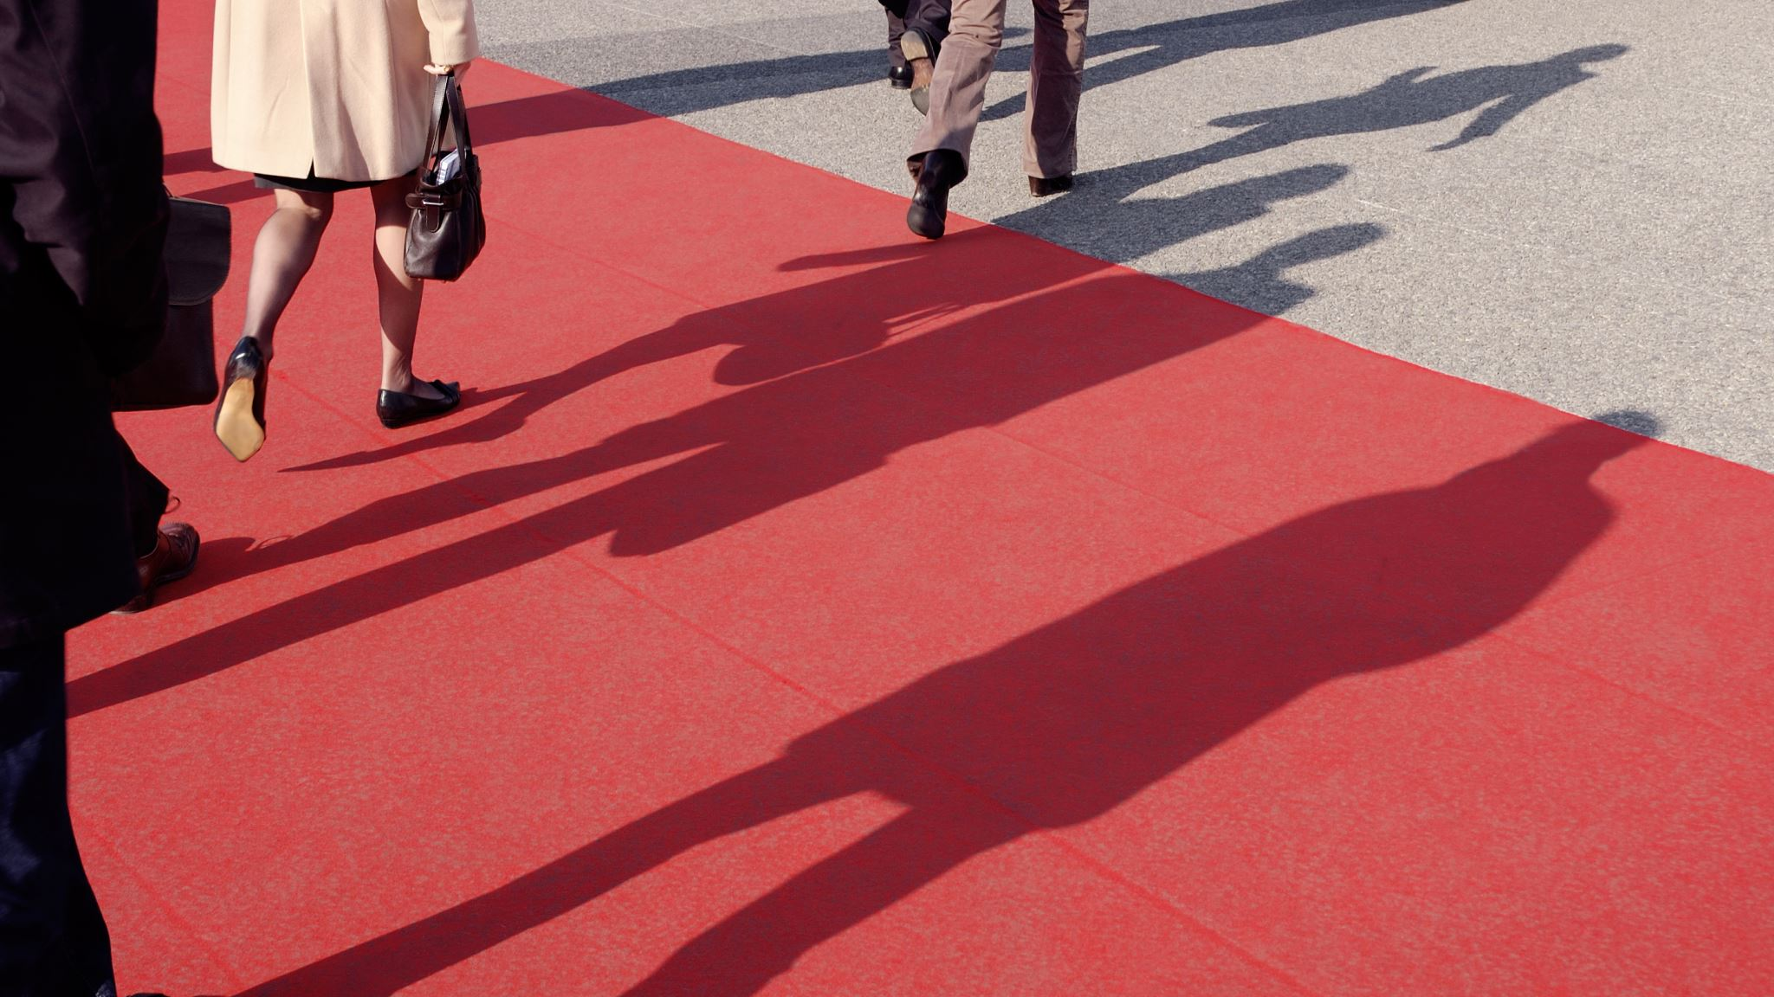
TIES ON RED CARPET – CHOICE OF STYLE
On the red carpet, celebrities often choose elegant and distinctive ties that reflect their personal style. The style of the tie can be classic, modern, daring or unusual, depending on personal taste.

Slide 11
TIES ON RED CARPET – COLORS AND PATTERNS
Ties can be used as a means of adding color and patterns to their outfit. On the red carpet, you can often see ties in different colors and designs that match or contrast with the outfit.

Slide 12
TIES ON RED CARPET – BRANDED TIES
At big events, celebrities often choose ties that are branded or designed by famous fashion houses. These ties can become part of their clothing brand and expression.

Slide 13
When you see photos of famous actors on the red carpet in magazines, they usually don't have their ties pulled all the way up to their collars. And as experts advise, the reason is that this detail gives a sense of casualness in the style of 'I know I look great, but I didn't try at all'. Along with this style, there is also a suit handkerchief that sticks out from the top pocket.

Slide 14
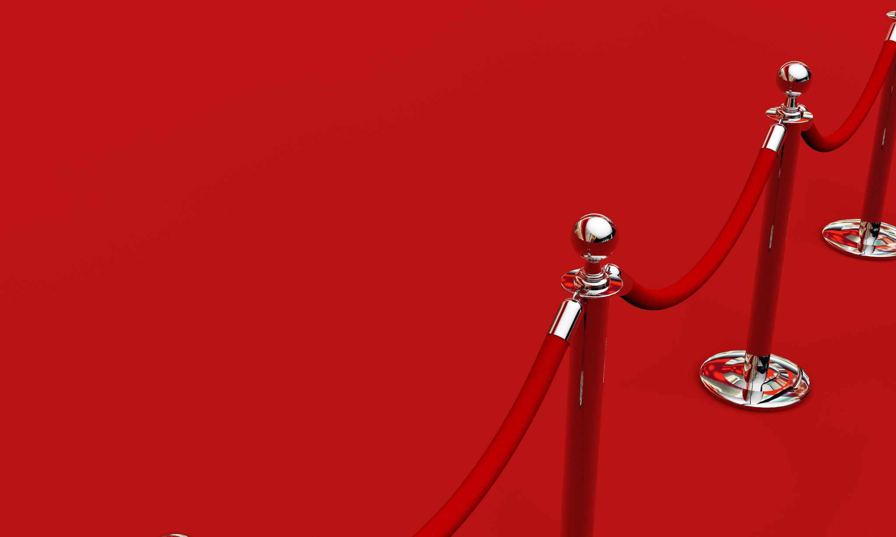
It is important to note that there are no hard rules on the red carpet and that much can be expressed through fashion choices. Ties often play an important role in shaping the overall look and can be an expression of the creativity and style of famous personalities.

Slide 15
British Prime Minister Winston Churchill was often seen in his characteristic colorful ties.

Slide 16
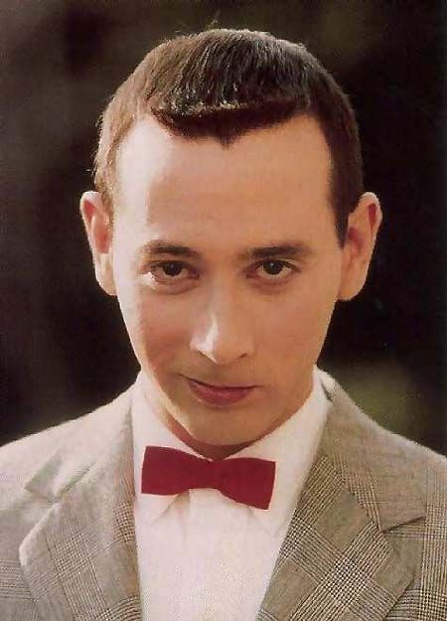
The character Pee-wee Herman, played by Paul Reubens, was known for his funny and eccentric ties.

Slide 17
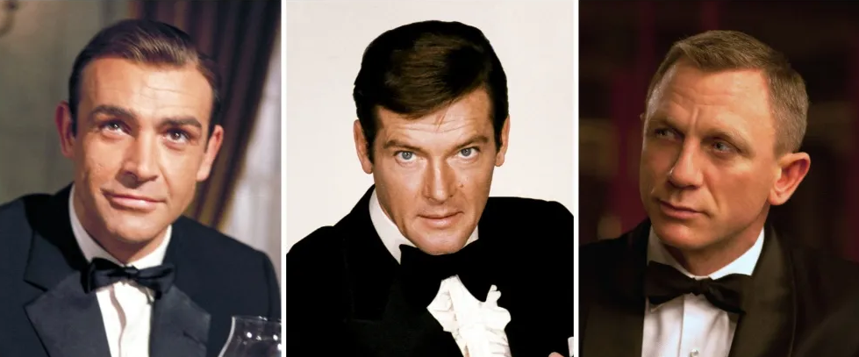
The character James Bond was often shown in elegant suits and ties, which became part of his signature style.

Slide 18
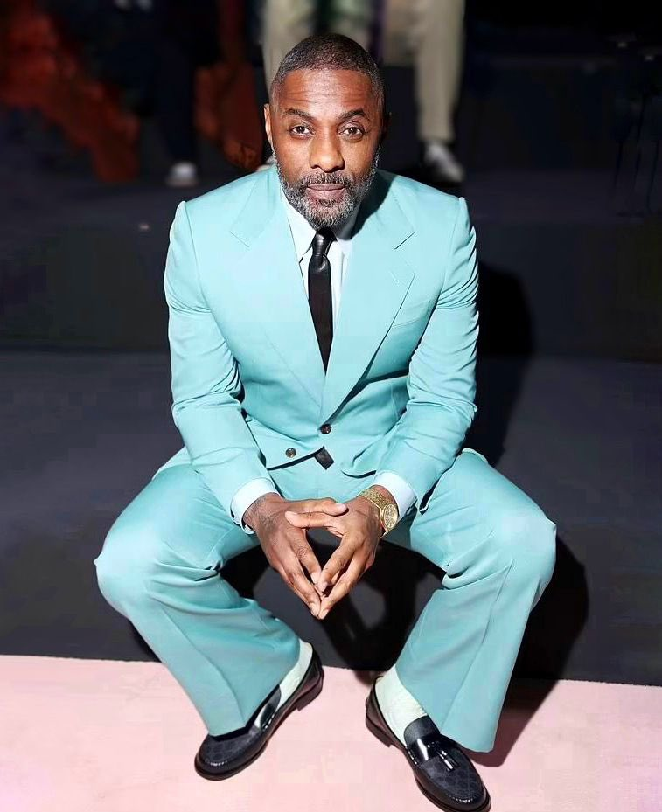
Actor Idris Elba wears ties on red carpets and in his roles, adding to his sophisticated look.

Slide 19
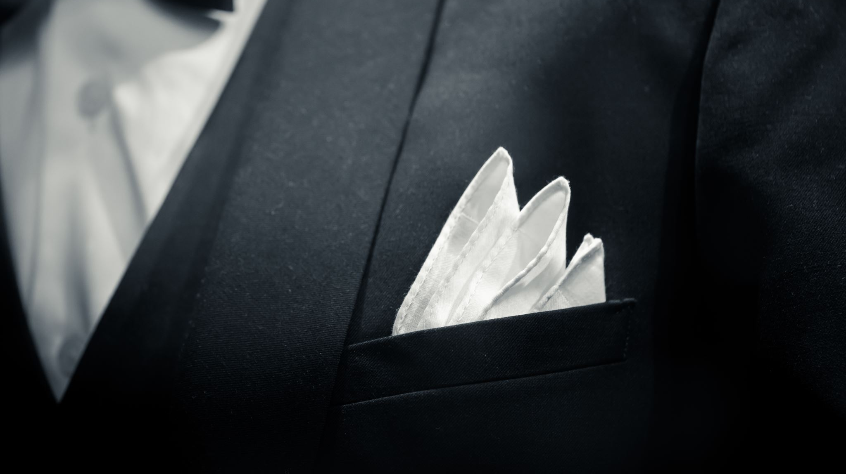
These examples show how ties can be an important part of the style and recognizable appearance of many famous people, whether they are politicians, actors, musicians, sportsmen or fashion icons.

