Slide 1
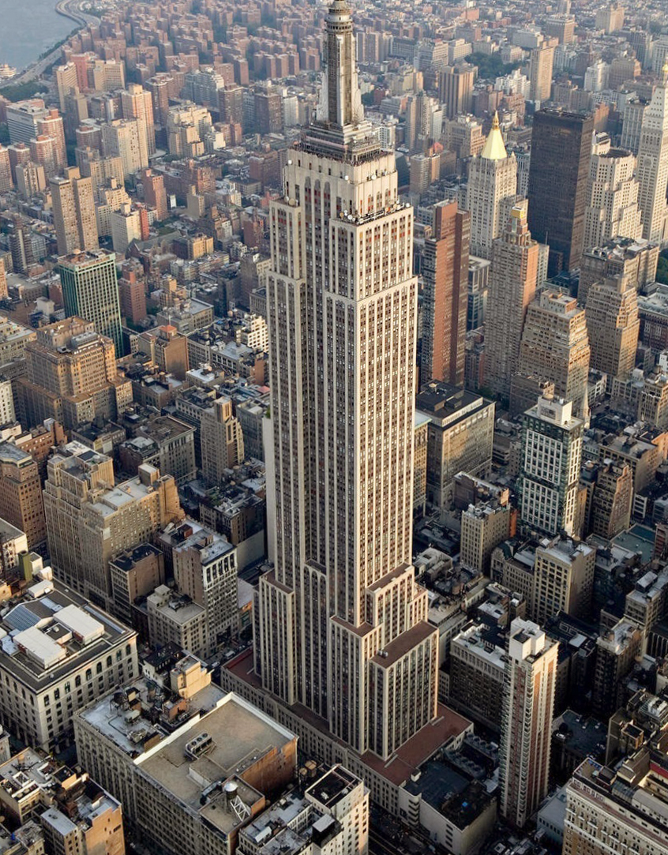
Empire state building
By: Dorian Dražić-Karalić

Slide 2
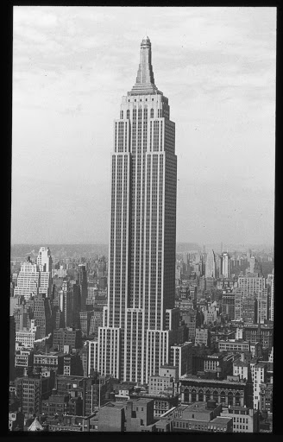
History
Bethlehem Engineering Corporation originally intended to build a 25-story office building on the Waldorf–Astoria site.
After faling to secure additional funds the land was resold to Empire State Inc.
The original plan of the building was 50 stories, but was later increased to 60 and then 80 stories. Height restrictions were placed on nearby buildings to ensure that the top fifty floors of the planned 80-story, 1,000-foot-tall (300 m) building would have unobstructed views of the city.

Slide 3
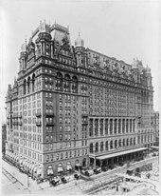
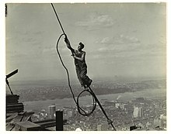
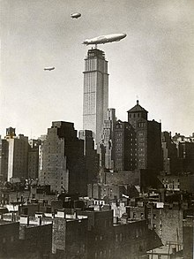

Slide 4
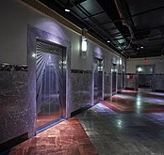
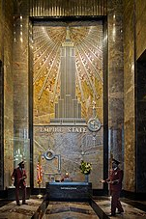
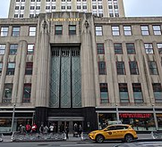
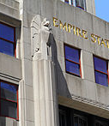
Design
The Empire State Building is 381 m tall to its 102nd floor, or 443.092 m including its 61.9 m pinnacle.
The building has 86 usable stories; the first through 85th floors contain commercial and office space, while the 86th story contains an observatory.
The remaining 16 stories are part of the Art Deco spire, which is capped by an observatory on the 102nd floor
The Empire State Building was the first building to have more than 100 floors.

Slide 5
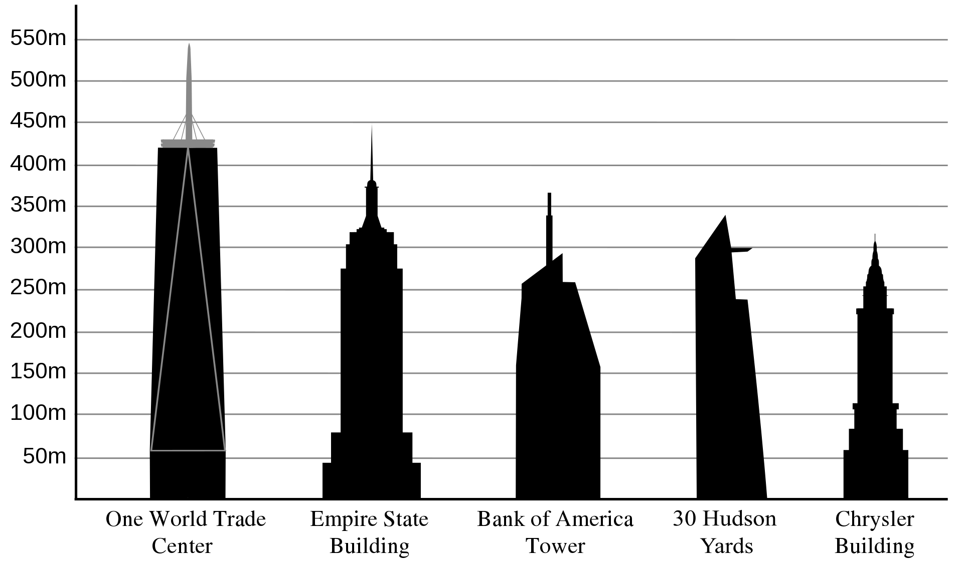
Tallest building title
The longest world record held by the Empire State Building was for the tallest skyscraper (to structural height), which it held for 42 years until it was surpassed by the North Tower of the World Trade Center in October 1970.
The Empire State Building was also the tallest man-made structure in the world before it was surpassed by the Griffin Television Tower Oklahoma in 1954, and the tallest freestanding structure in the world until the completion of the Ostankino Tower.
With the destruction of the World Trade Center in the September 11 attacks, the Empire State Building again became the tallest building in New York City, and the second-tallest building in the Americas, surpassed only by the Willis Tower in Chicago.
The Empire State Building remained the tallest building in New York until the new One World Trade Center reached a greater height in April 2012

Slide 6
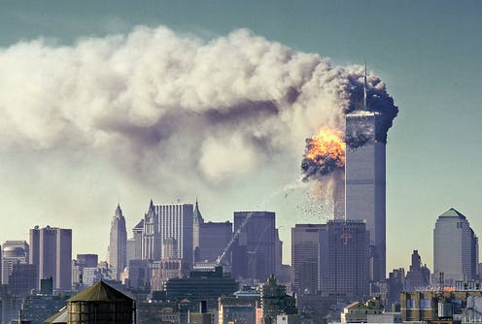
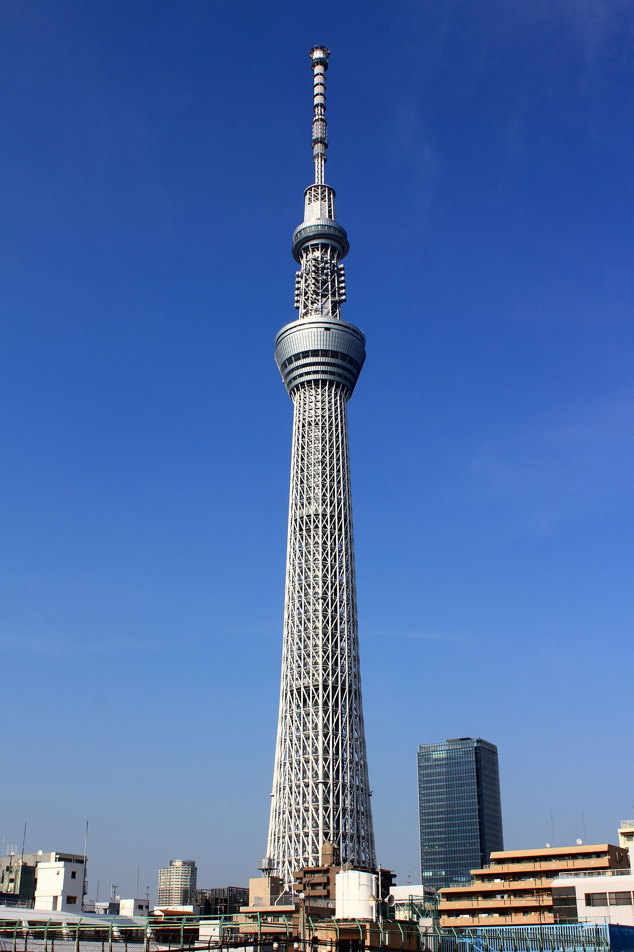
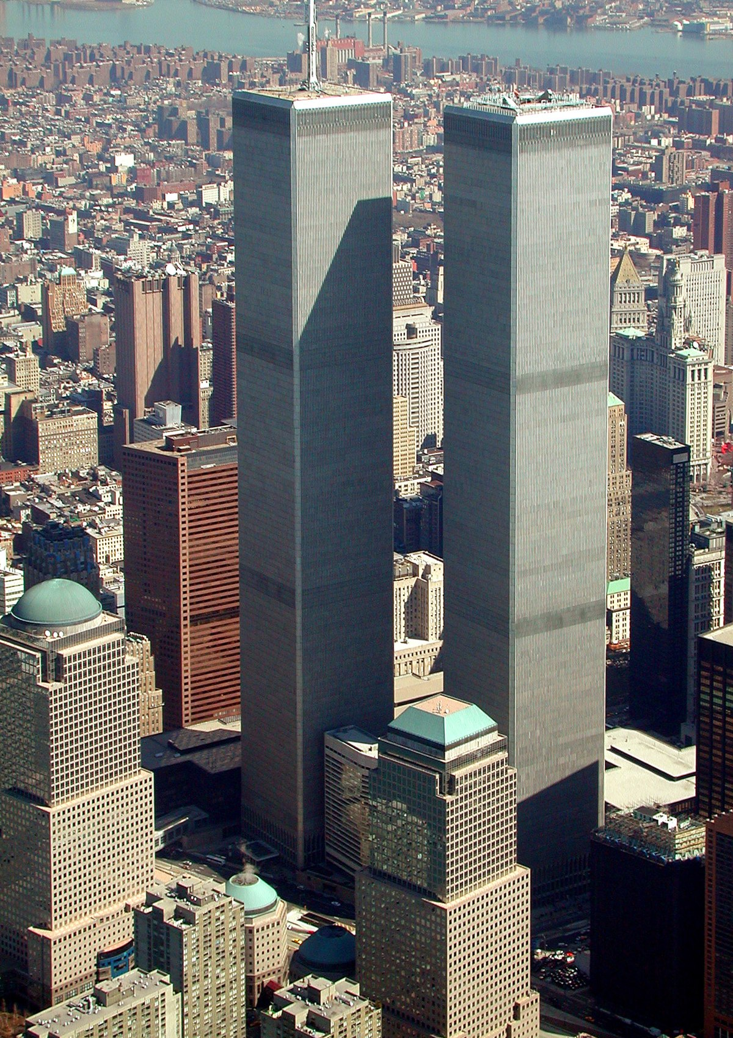
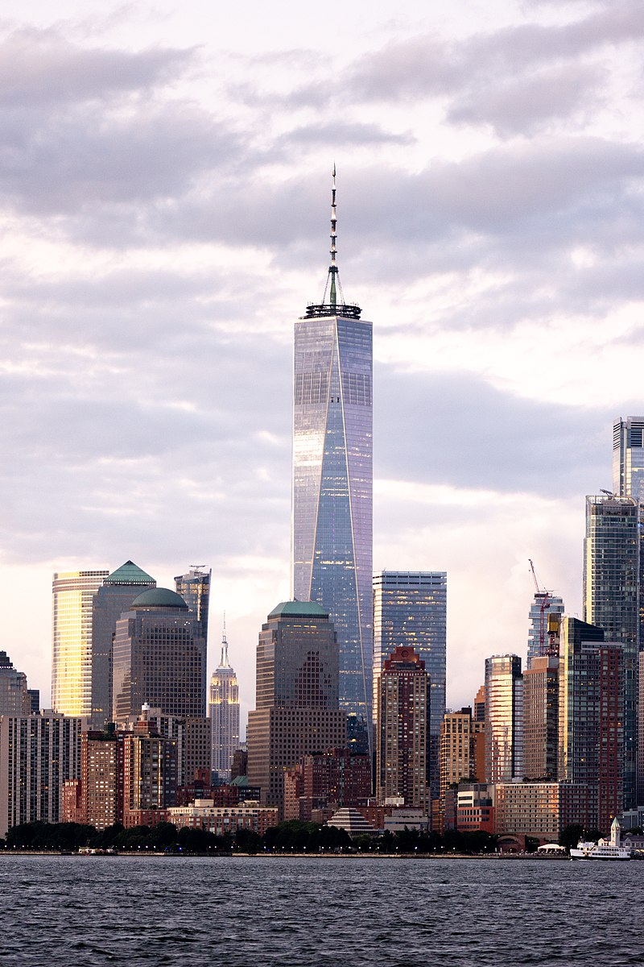
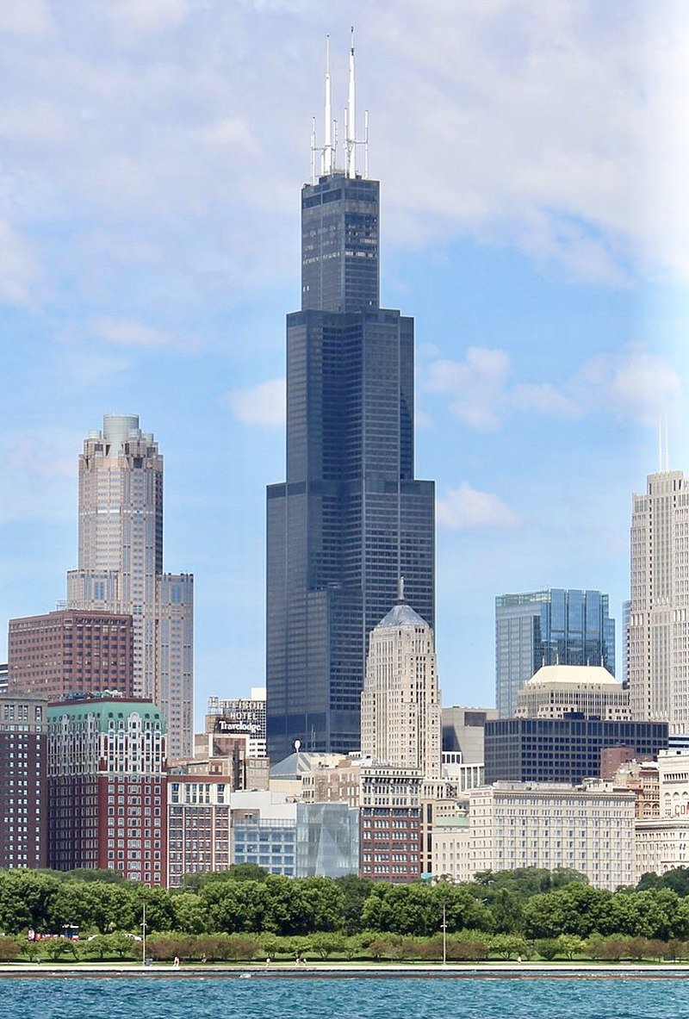
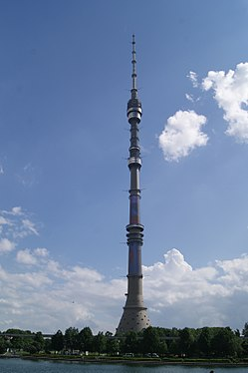

Slide 7
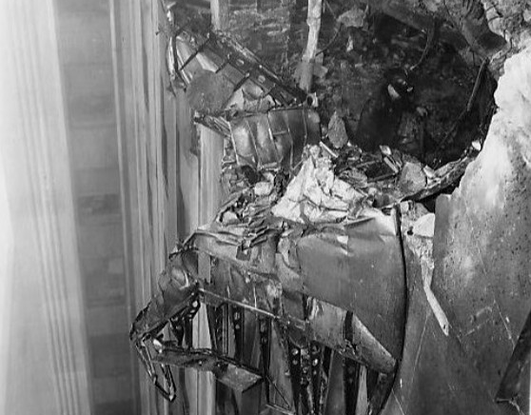
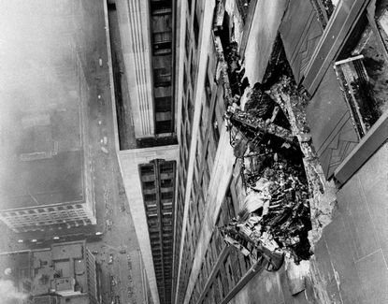
Incidents
1945 plane crash
At 9:40 am on July 28, 1945, a B-25 Mitchell bomber, piloted in thick fog by Lieutenant Colonel William Franklin Smith Jr., crashed into the north side of the Empire State Building between the 79th and 80th floors where the offices of the National Catholic Welfare Council were located.
One engine completely penetrated the building, landing on the roof of a nearby building where it started a fire that destroyed a penthouse. T
he other engine and part of the landing gear plummeted down an elevator shaft causing a fire, which was extinguished in 40 minutes.
Fourteen people were killed in the incident. Elevator operator Betty Lou Oliver survived a plunge of 75 stories inside an elevator, which still stands as the Guinness World Record for the longest survived elevator fall recorded.

Slide 8
2000 elevator plunge
On January 24, 2000, an elevator in the building suddenly descended 40 stories after a cable that controlled the cabin's maximum speed was severed.
The elevator fell from the 44th floor to the fourth floor, where a narrowed elevator shaft provided a second safety system.
Despite the 40-floor fall, both of the passengers in the cabin at the time were only slightly injured.
Since that elevator had no fourth-floor doors, the passengers were rescued by an adjacent elevator. After the fall, building inspectors reviewed all of the building's elevators.

Slide 9
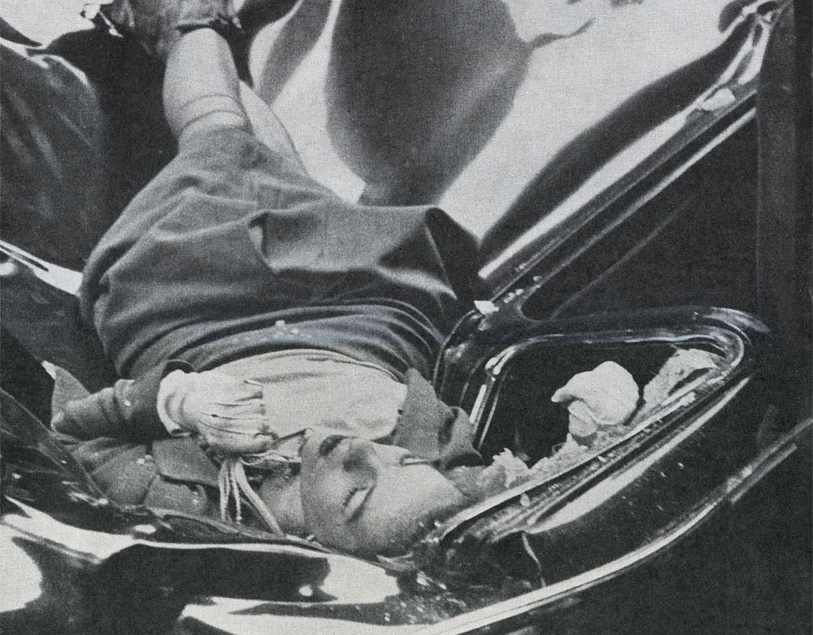
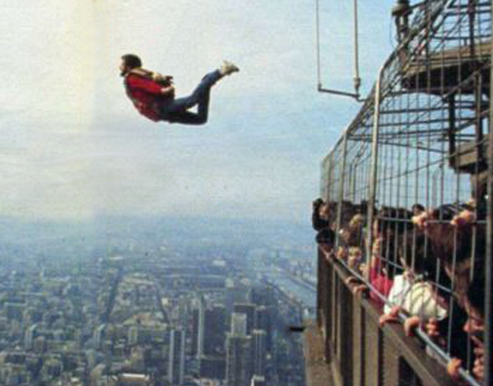
Suicide attempts
Because of the building's iconic status, it and other Midtown landmarks are popular locations for suicide attempts.More than 30 people have attempted suicide over the years by jumping from the upper parts of the building, with most attempts being successful.
The first suicide from the building occurred on April 7, 1931, before it was even completed, when a carpenter who had been laid-off went to the 58th floor and jumped.
The first suicide after the building's opening occurred from the 86th floor observatory in February 1935, when Irma P. Eberhardt fell 314 m onto a marquee.

Slide 10
Shootings
Two fatal shootings have occurred in the direct vicinity of the Empire State Building.
Abu Kamal, a 69-year-old Palestinian teacher, shot seven people on the 86th floor observation deck during the afternoon of February 23, 1997. He killed one person and wounded six others before committing suicide. Kamal reportedly committed the shooting in response to events happening in Palestine and Israel.
On the morning of August 24, 2012, 58-year-old Jeffrey T. Johnson shot and killed a former co-worker on the building's Fifth Avenue sidewalk. He had been laid off from his job in 2011. Two police officers confronted the gunman, and he aimed his firearm at them. They responded by firing 16 shots, killing him but also wounding nine bystanders. Most of the injured were hit by bullet fragments, although three took direct hits from bullets.

Slide 11
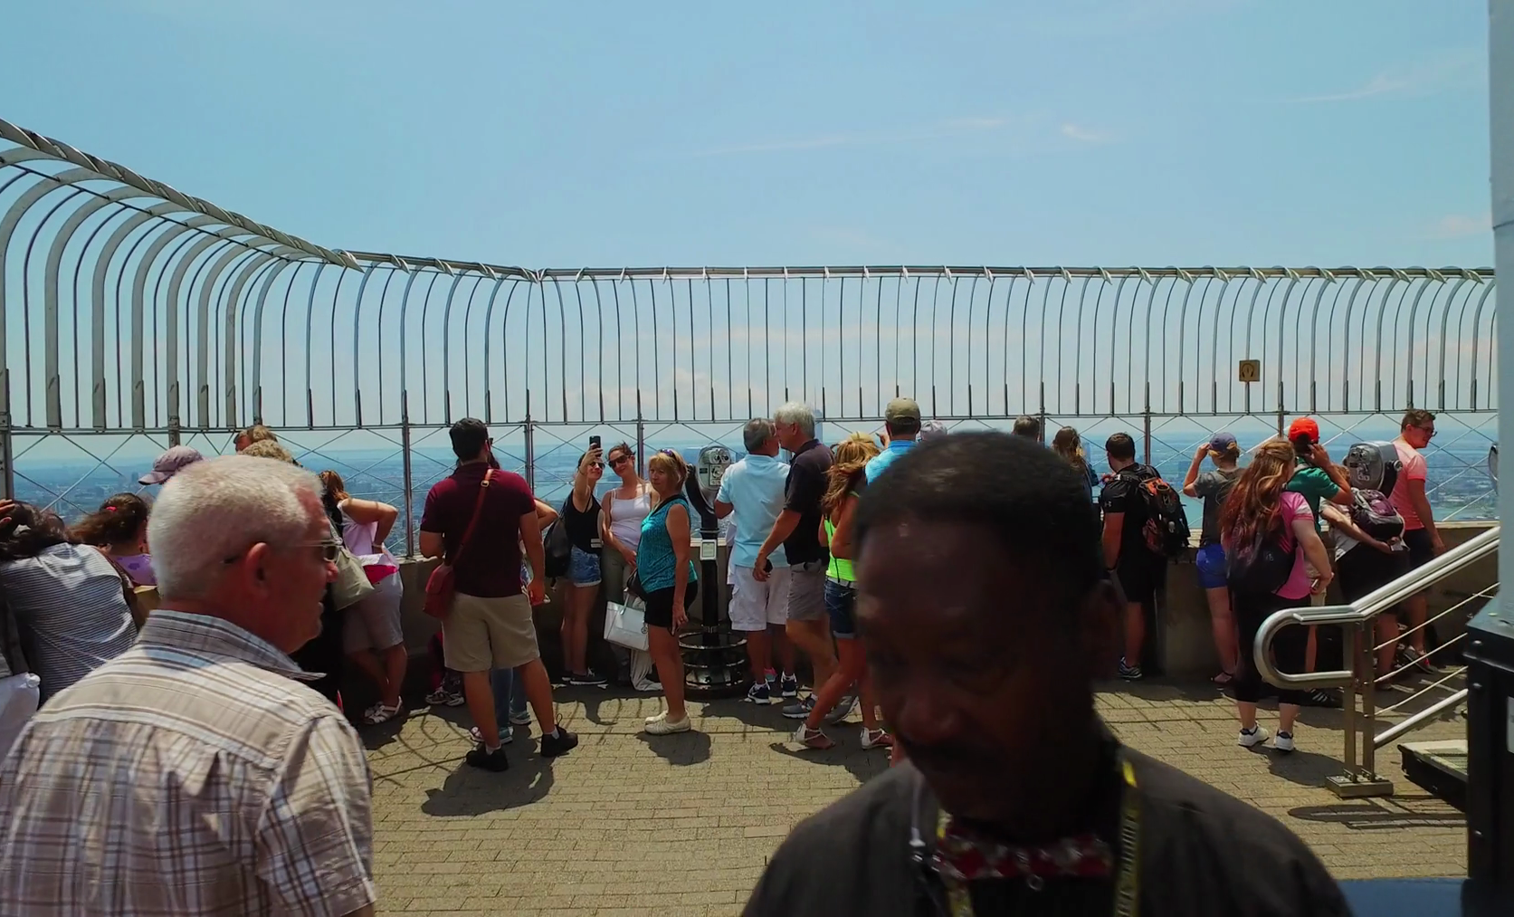
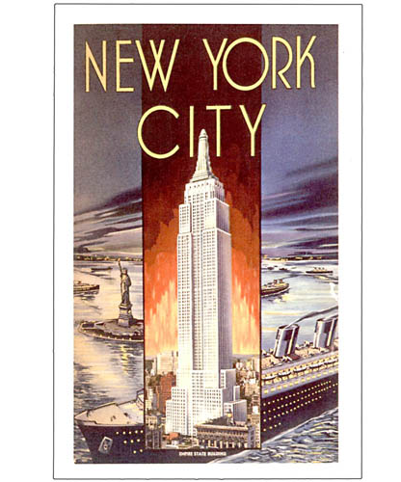
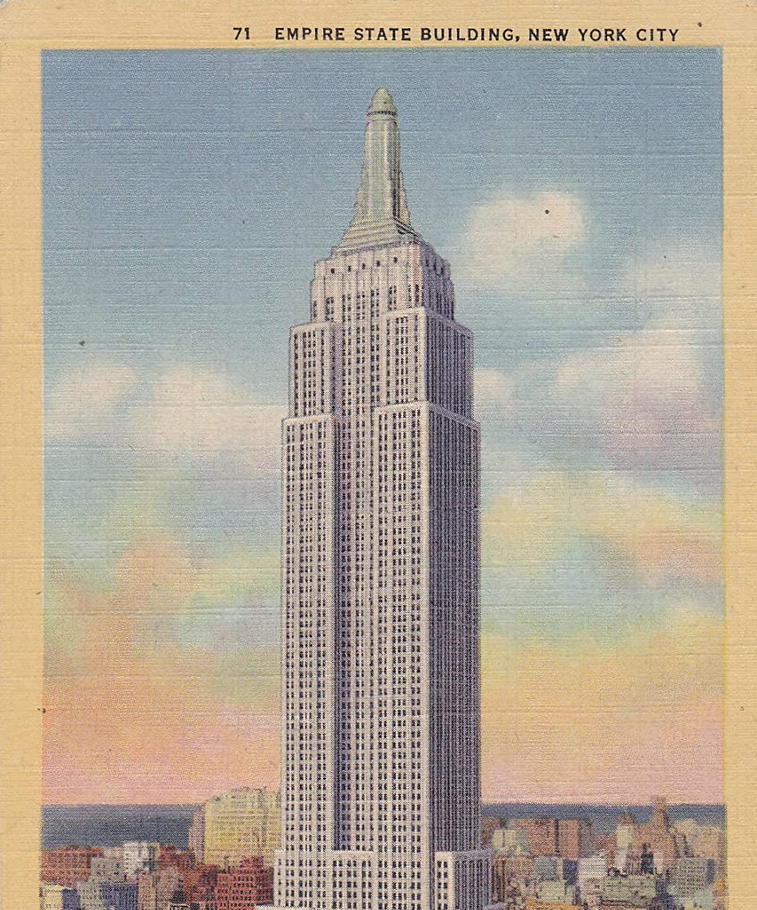
Impact
As the tallest building in the world and the first one to exceed 100 floors, the Empire State Building immediately became an icon of the city and of the nation.
In 2013, Time magazine noted that the Empire State Building "seems to completely embody the city it has become synonymous with".
The historian John Tauranac called it "'the' twentieth-century New York building", despite the existence of taller and more modernist buildings.

Slide 12
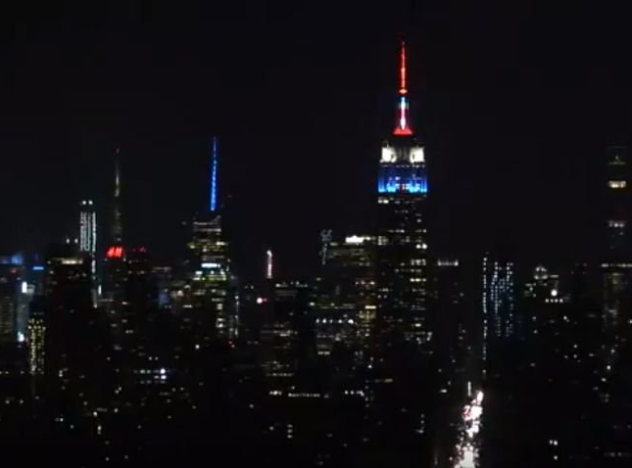
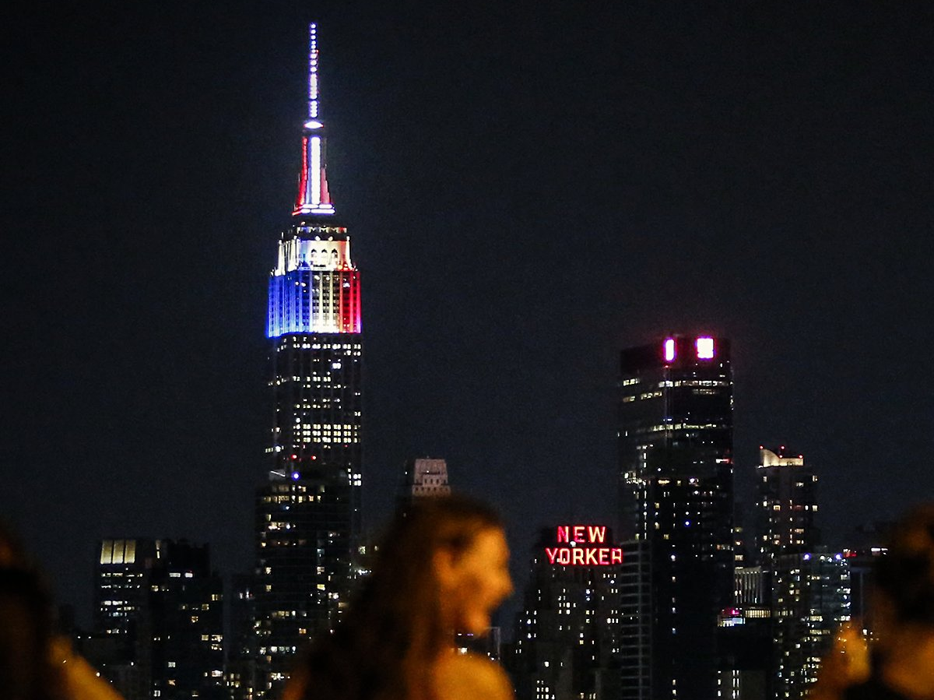
The End

