Slide 1
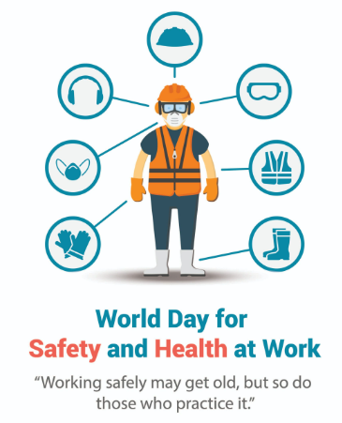
World Day for Safety and Health at Work

Slide 2
World Day for Safety and Health at Work
World Day for Safety and Health at Work is a UN international day that is celebrated every April 28.
It is concerned about safe work and awareness of the dimensions and consequences of work-related accidents and diseases; to place occupational safety and health (OSH) on the international and national agendas; and to provide support to the national efforts for the improvement of national OSH systems and programmes in line with relevant international labor standards.
It coincides with Workers' Memorial Day and the Canadian National Day of Mourning.
World Day for Safety and Health at Work was first celebrated by the International Labour Organization in 2003.

Slide 3
World Day for Safety and Health at Work 2023
World Day for Safety and Health at Work 2023 will explore the topic of a safe and healthy working environment as a fundamental principle and right at work.
World Day for Safety and Health at Work is celebrated annually to promote the prevention of occupational accidents and diseases globally. It is an awareness-raising campaign intended to focus international attention on the magnitude of the problem and on how promoting and creating a safety and health culture can help reduce the number of work-related deaths and injuries.

Slide 4
WHY WE LOVE WORLD DAY FOR SAFETY AND HEALTH AT WORK
A. We get to learn
There is so much to understand and tackle with the topic of safety and health at work. Identifying hazards that cause injuries at work is a good place to start.
B. It’s universal
Unsafe workplaces are risky and therefore undesirable. Safety and health are a form of social justice that every employee deserves in their work environment.
C. We get to practice
This national holiday reminds us to implement safe work practices. The ILO doesn’t just teach us the importance of a safe workplace but reinforces the need to apply safety measures in our day-to-day activities.

Slide 5
4 FACTS ABOUT WORLD DAY FOR SAFETY AND HEALTH AT WORK
It started through the ILO
The ILO got involved with this holiday as a request from the trade union movement.
April 28 is also another holiday
International Commemoration Day for Dead and Injured Workers, initiated in 1996 is also observed today.
The holiday maintains its relevance
The holiday has been observed for close to 20 years and it is still very relevant in the workplace.
A unified progress is formed
The United Nations has a global plan of action called the ‘2030 Agenda for Sustainable Development.

