Slide 1
Victims of the Holocaust
MADE BY: Lovro, Luka,
Dario, Mateo, Nikola

Slide 2
World War II.
Lasted from 1939. to 1945.
Combatants: Allies; France, Great Britain, USA and Soviet Union
Axis Forces; Germany, Italy and Japan
At least 40 million people died
Adolf Hitler
World War II.

Slide 3
Who was Adolf Hitler?
He was born in Austria in 1889.
He was a dictator of Nazi-Germany and he initiated WW.II.
He was spreading antisemitism
He killed himself in 1945.

Slide 4
What is Holocaust?
The Holocaust, also known as the Shoah, was the genocide of European Jews during World War II. Between 1941 and 1945, Nazi Germany and its collaborators systematically murdered some six million Jews across German-occupied Europe around two-thirds of Europe's Jewish population.

Slide 5
Concentration camps
Nazi Germany ran more than a thousand concentration camps between the years of 1933 and 1945, both on its own soil and in areas of German-occupied Europe.

Slide 6
Auschwitz
The biggest Nazi concentration and extermination camp, Auschwitz, also known as Auschwitz-Birkenau, opened its doors in 1940. Auschwitz, which lies in southern Poland, started out as a facility for holding political prisoners. But it eventually turned into a network of concentration camps where Jews and other people who were seen as Nazi adversaries were murdered, frequently in gas chambers, or forced to work as slaves.

Slide 7
Additionally, some captives were the targets of horrific medical experiments carried out by Josef Mengele (1911-79). According to some estimates, Auschwitz saw the deaths of over 1 million individuals between 1939 and 1945, during World War II. Nazi leaders ordered the camp to be abandoned in January 1945 as the Soviet army drew near, and they forced an estimated 60,000 captives to march to new places. Numerous thousands of malnourished prisoners and mountains of bodies were left behind when the Soviets entered Auschwitz.

Slide 8
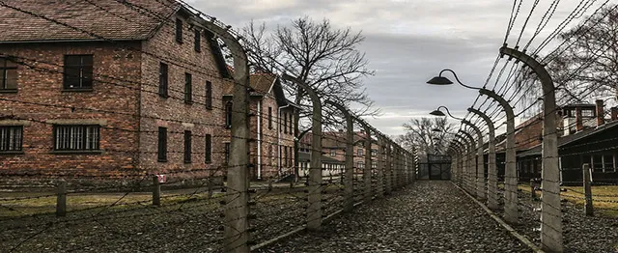

Slide 9
Anne Frank
Jewish In 1942, when the Nazis were occupying the Netherlands, Anne Frank hid from them. She was found two years later. In the Bergen-Belsen detention camp, she passed away in 1945.
In her diary she was writing about
the war and concentration camps.

Slide 10
Mittelbau-Dora
The National Socialist concentration camp system's novel camp type, Mittelbau-Dora, which is not reflected by other concentration camp memorials, is a model example of forced labor by camp inmates. Between 1943 and 1945, over 60,000 people were sent to the Harz Mountains as inmates of concentration camps to conduct forced labor for the German armament industry, with the Soviet Union, Poland, and France being the most heavily represented.

Slide 11
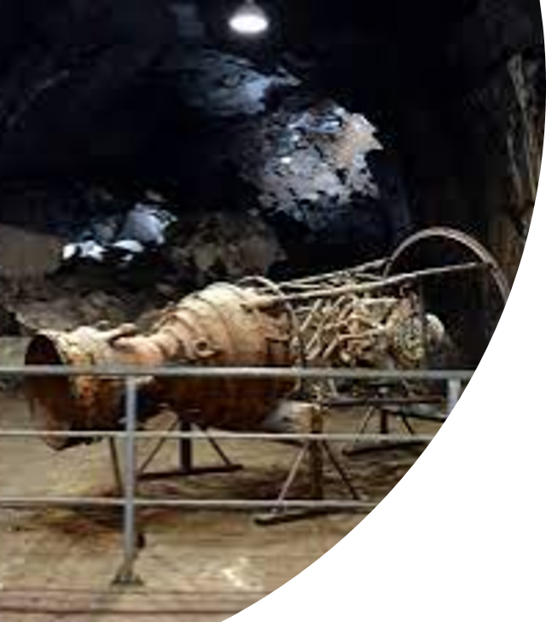
Rocket engine made by Jews

Slide 12
V-2 rocket

Slide 13
ttps://youtu.be/Ige_PtiJuKw

Slide 14
Slike: 1. 2. 3. 4. 5. 6. 7. 8. 9.
Video: ttps://youtu.be/Ige_PtiJuKw
Izvori: Wikipedia,
1 2 3 4

Slide 15
The End
Thank you for your attention

